Slide 1
IoT Data-modelling using Time Series Database
24 February 2019

Slide 2
Tracker
IOT v/s IIOT
Time series database
Graphite + Influx
Short Demo
Reporting

Slide 3
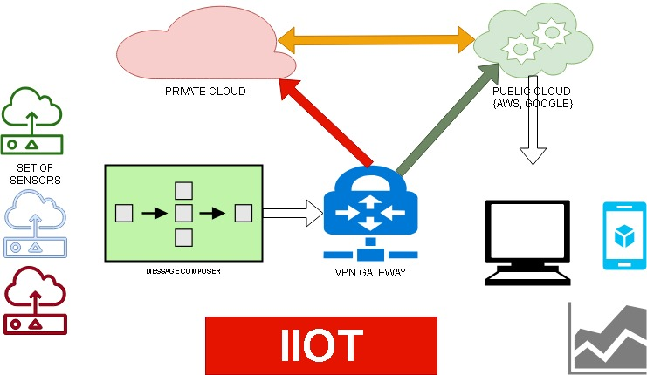
IIOT DATA FLOW

Slide 4
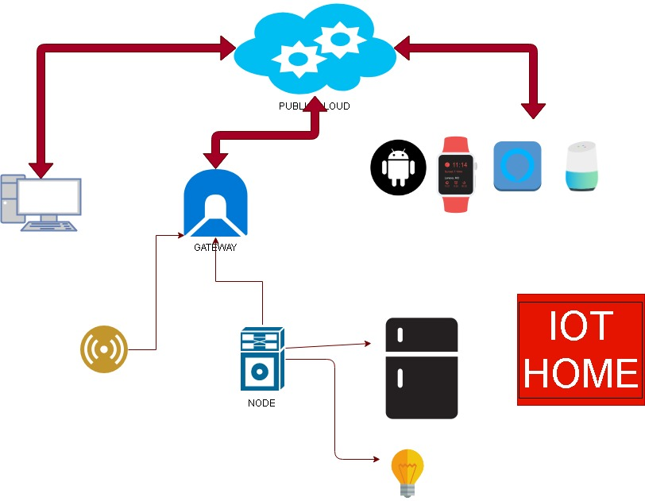
IOT DATA FLOW

Slide 5
IOT VS IIOT
SMALL DATA SIZE
Human intervention to end node
Security is *USUALLY* LOW
Sensors are usually with lower sensitivity
Public cloud
OOTB Analytics
HUUUUUUGE DATA
Human intervention is very less
Higher security
Extremely high sensitive sensors
Private cloud AND/OR Public cloud
Very high level of specific, targetted, directed analytics

Slide 6
Tools
Sensor data processor
Message processor
Gateway with VPN
Streaming data
Data saving
Scheduler for data processing
Reporting

Slide 7
IOT and Analytics
Need for Analytics
Raw Data vs Aggregated Data
Learning from Raw data
Descriptive, Diagnostic, Prescriptive
Save analysis output to TSDB again

Slide 8
Tracker
IOT v/s IIOT
Time series database
Graphite + Influx
Short Demo
Reporting

Slide 9
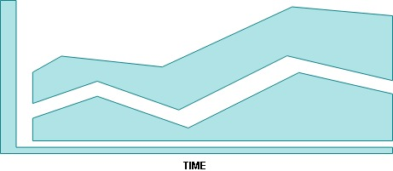
Timeseries Database [tsdb]
X-Axis is ALWAYS time
A time series is a sequence taken at successive equally spaced points in time. it is a sequence of discrete-time data
Time series analysis is the use of statistical methods to analyze time series data and extract meaningful statistics and characteristics about the data.

Slide 10
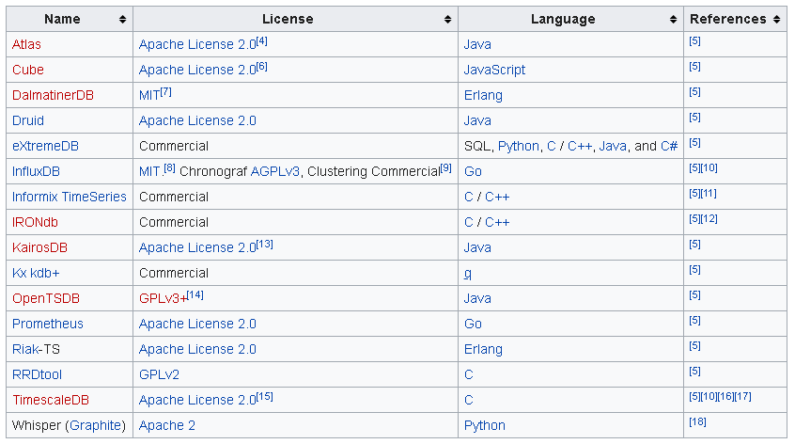
List of timeseries databases

Slide 11
Kairos DB
put <metric name> <time stamp> <value> <tag> <tag>... \n
[{ "name": "archive.file.tracked", "timestamp": 1349109376, "type": "long", "value": 123, "tags":{"host":"test"} }, { "name": "archive.file.search", "timestamp": 999, "type": "double", "value": 32.1, "tags":{"host":"test"} }]

Slide 12
Influx DB
weather,location=us-midwest temperature=82 1465839830100400200 | -------------------- -------------- | | | | | | | | | +-----------+--------+-+---------+-+---------+ |measurement|,tag_set| |field_set| |timestamp| +-----------+--------+-+---------+-+---------+
curl -i -XPOST "http://localhost:8086/write?db=science_is_cool" --data-binary 'weather,location=us-midwest temperature=82 1465839830100400200'
INSERT weather,location=us-midwest temperature=81i 1465839830100400300

Slide 13
Tracker
IOT v/s IIOT
Time series database
Graphite + Influx
Short Demo
Reporting

Slide 14
Graphite Protocol
Graphite Project -Graphite web, carbon+ carbon relay, Whisper database
Graphite/Carbon protocol -responsible for receiving metrics over the network and writing them down to disk using a storage backend.
Both Kairos DB and Influx DB Support this
echo "measurement_name `date +%s`" | nc graphite.example.com 2003

Slide 15
Tracker
IOT v/s IIOT
Time series database
Graphite + Influx
Short Demo
Reporting

Slide 16
Tracker
IOT v/s IIOT
Time series database
Graphite + Influx
Short Demo
Reporting

Slide 17
Reporting
Web UI
Mobile
Voice
Reinforcements
IOT - make adjustments?

Slide 18
Thank you!
@vikramaroskar
vikram (dot) aroskar (at) gmail (dot) com
https://medium.com/@vikramaroskar

